Slide 1



Intro to Web Development
Dipesh Trikam
Juan Paolo

Slide 2
Why Web Development?
Difference between Web App and Website?
Dynamic vs Static
Why not Mobile App?
Cross Platform
Notes:
Difference between Web App and Website:
Dynamic vs Static
Examples of Web Apps
Examples of Websites
Why not Mobile App?
Examples of Mobile Apps
Cross Platform
Static Web Pages
Static Web pages display the exact same information whenever anyone visits it. Static Web pages do not have to be simple plain text. They can feature detailed multimedia design and even videos. However, every visitor to that page will be greeted by the exact same text, multimedia design or video every time he visits the page until you alter that page's source code.
Dynamic Web Pages
Dynamic Web pages are capable of producing different content for different visitors from the same source code file. The website can display different content based on what operating system or browser the visitor is using, whether she is using a PC or a mobile device, or even the source that referred the visitor. A dynamic Web page is not necessarily better than a static Web page. The two simply serve different purposes.

Slide 3
You’re already doing it!
Every device has a browser
Important that the page follows responsive design principals (e.g. using Bootstrap template)

Slide 4

Web App

Slide 5
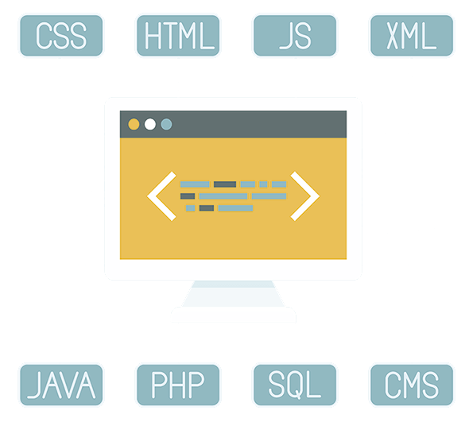
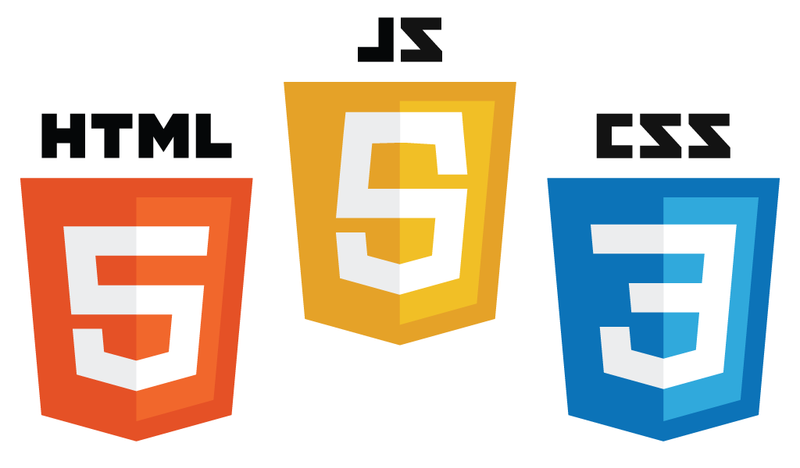
Various components

Slide 6
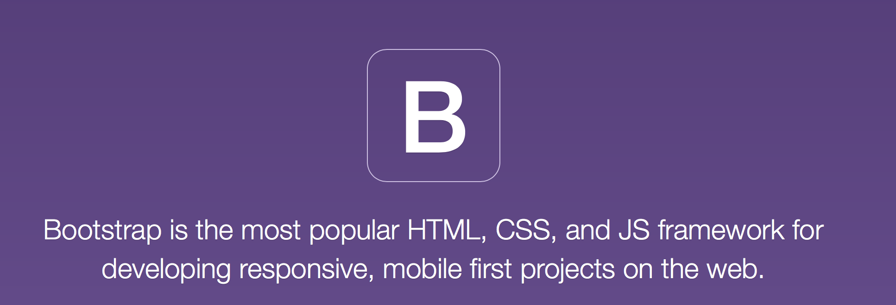
What is Bootstrap
Front-end framework for faster and easier web development
Mobile-first approach
Responsive web design
Websites automatically adjust to the screen size

Slide 7
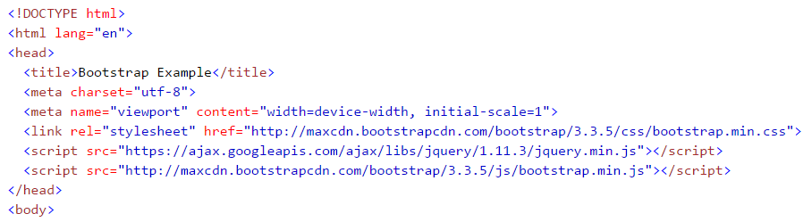


How to get Bootstrap
Download Bootstrap and host it yourself
Use Bootstrap CDN (Content Deliver Network)
MaxCDN provides CDN support for bootstrap’s CSS and JavaScript

Slide 8


HTML
Defining the Contents of the Web Page
Layout
Basics
Tables
Text
Images
Links
HTML and CSS
Lists

Slide 9
Basics
Can be edited in any text editor
Built In: Notepad (PC), TextEdit (Mac)
Download: Notepad++ (PC), Sublime Text (Mac)
Save as: index.html / index.htm
These are the same – no difference at all
Layout
Basics
Tables
Text
Images
Links
HTML and CSS
Lists
Notes:
Text Editors include vs code - works on everything - linux mac windows

Slide 10
Basics
Hyper Text Markup Language
Markup Language – a set of markup tags
HTML – HTML Tags
Each tag describes a different document content
Layout
Basics
Tables
Text
Images
Links
HTML and CSS
Lists
Notes:
Hyper Text Markup Language
Markup Language – is a set of markup tags
Example of other markup languages – e.g. Markdown
HTML – HTML Tags
Each tag describes a different document content
DOCTYPE surrounds the entire page structure (shown) – displays a document correctly – not case sensitive
Examples: html, head, title, body, h1, p

Slide 11
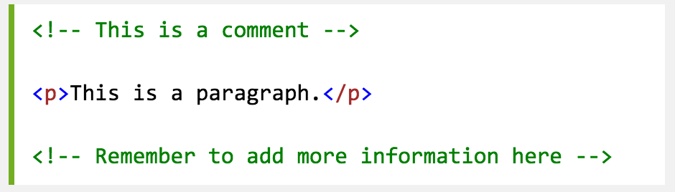
Basics
Commenting
Layout
Basics
Tables
Text
Images
Links
HTML and CSS
Lists
Notes:
Hyper Text Markup Language
Markup Language – is a set of markup tags
Example of other markup languages – e.g. Markdown
HTML – HTML Tags
Each tag describes a different document content
DOCTYPE surrounds the entire page structure (shown) – displays a document correctly – not case sensitive
Examples: html, head, title, body, h1, p

Slide 12
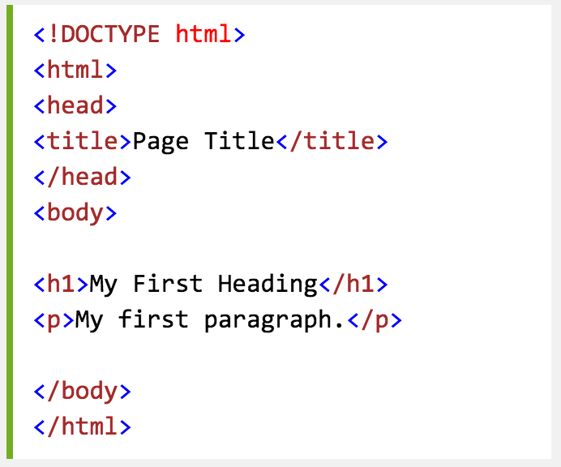
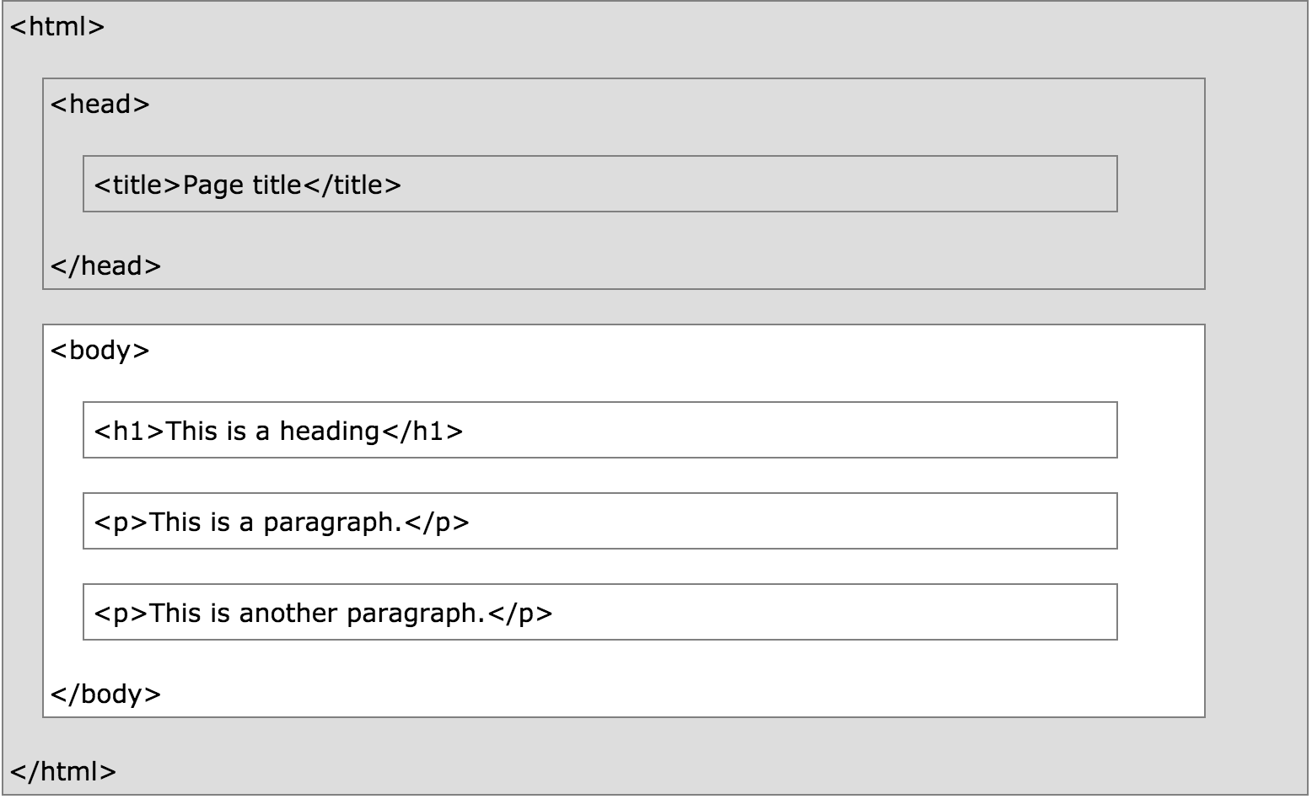
Layout
Layout
Basics
Tables
Text
Images
Links
HTML and CSS
Lists
Notes:
Note: <title> tag puts it where ‘index.htm’ is.
Remember to do the end tag!
DOCTYPE surrounds the entire page structure (shown) – displays a document correctly – not case sensitive
Examples: html, head, title, body, h1, p

Slide 13
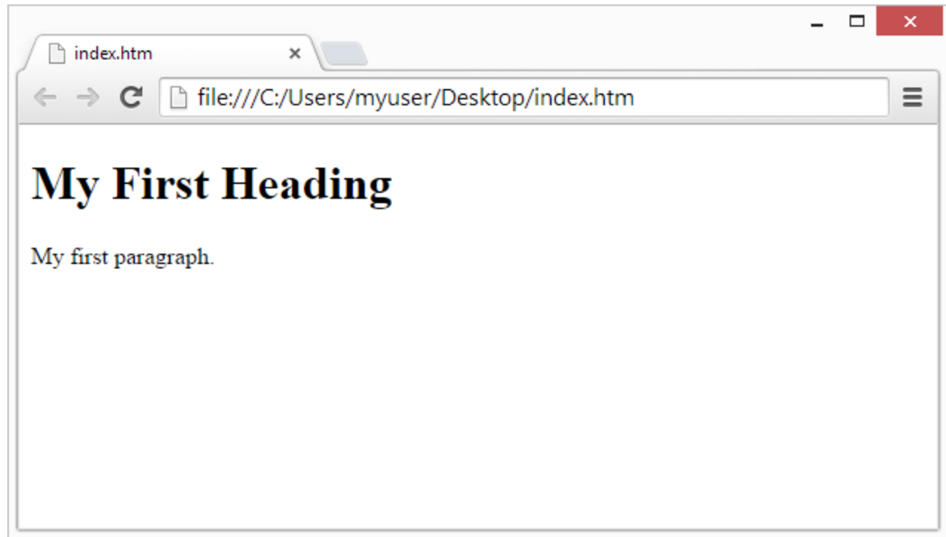
Layout
Layout
Basics
Tables
Text
Images
Links
HTML and CSS
Lists
Notes:
Note: <title> tag puts it where ‘index.htm’ is.
Remember to do the end tag!

Slide 14
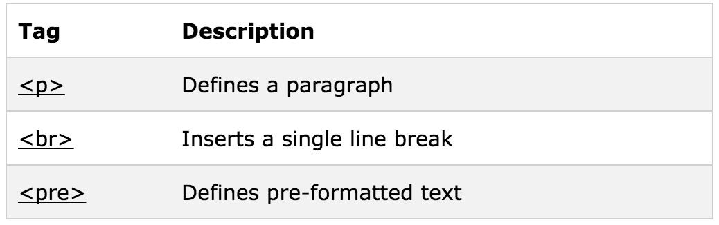
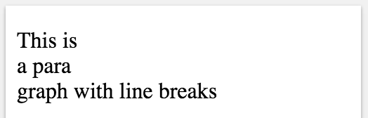
Text
Line Breaks
Layout
Basics
Tables
Text
Images
Links
HTML and CSS
Lists
Notes:
Line Breaks: Use line breaks if you want to have start on a new line – without making a new paragraph each time

Slide 15
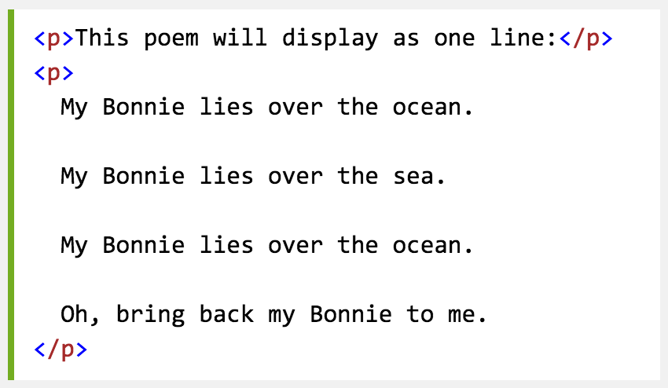
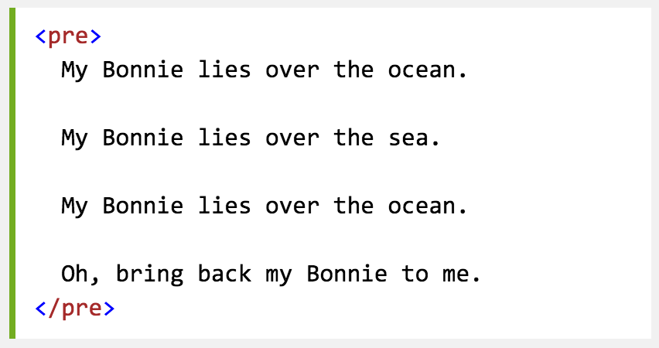
Text
Paragraph
Preformatted
Layout
Basics
Tables
Text
Images
Links
HTML and CSS
Lists

Slide 16
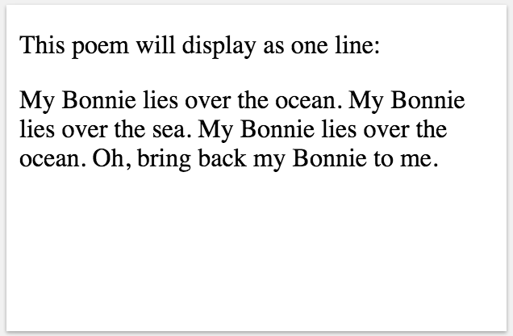
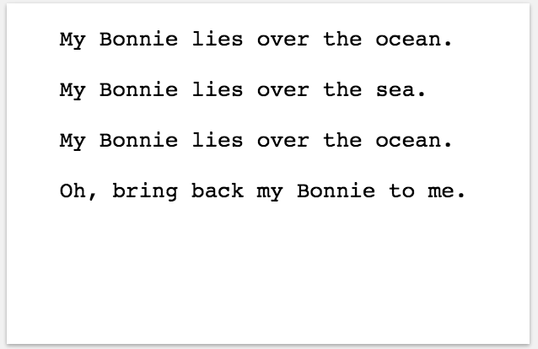
Text
Paragraph
Preformatted
Layout
Basics
Tables
Text
Images
Links
HTML and CSS
Lists

Slide 17
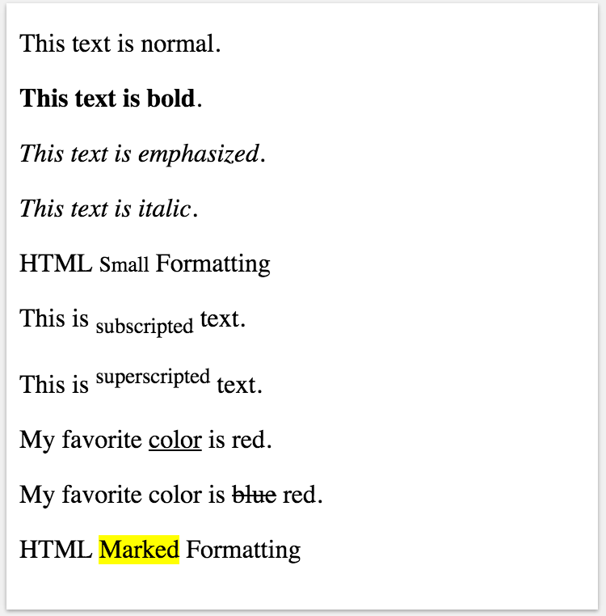
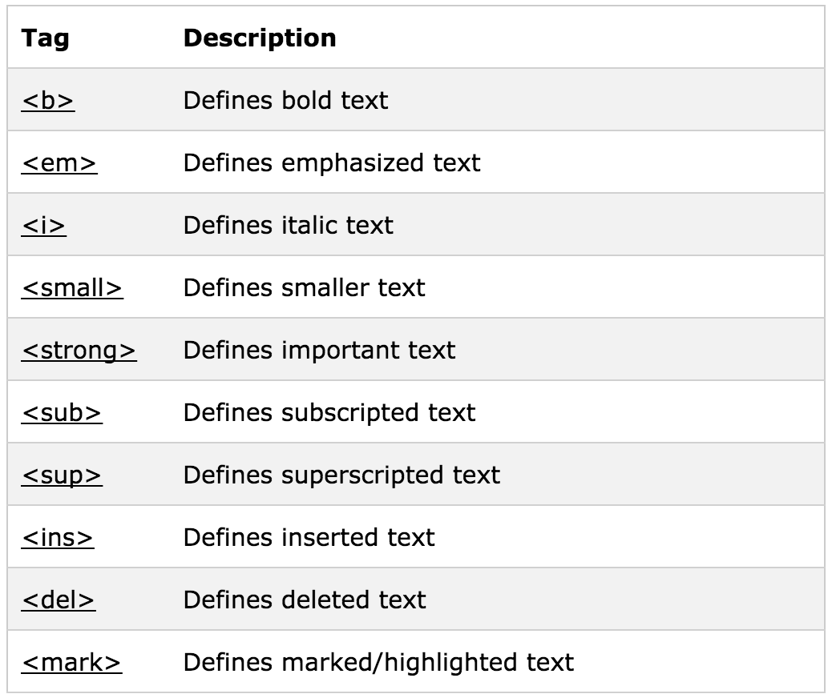
Text
Layout
Basics
Tables
Text
Images
Links
HTML and CSS
Lists
Notes:
Line Breaks: Use line breaks if you want to have start on a new line – without making a new paragraph each time

Slide 18
Links
HTML link = “hyperlink”
Text or image you can click on
Jumps to another document (another .html or .htm)
Layout
Basics
Tables
Text
Images
Links
HTML and CSS
Lists

Slide 19

Links
Links are defined with the <a> tag
Where you want your link to go using href
Link text: visible part
Layout
Basics
Tables
Text
Images
Links
HTML and CSS
Lists
Notes:
Talk about how you insert an image tag into the <a> HERE </a> to make an image linkable.

Slide 20
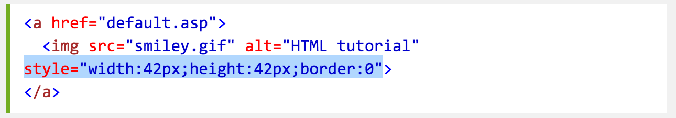
Links
Linking Text
Linking an Image
Layout
Basics
Tables
Text
Images
Links
HTML and CSS
Lists
Notes:
Talk about how you insert an image tag into the <a> HERE </a> to make an image linkable.
The style = if your image isn’t the size you want.
Images coming up soon

Slide 21
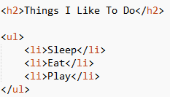
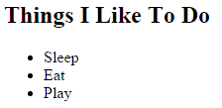
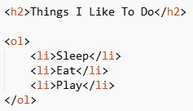
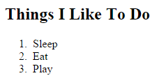
Lists
Ordered – Numbered List <ol> tag
Unordered – bullet points <ul> tag
Layout
Basics
Tables
Text
Images
Links
HTML and CSS
Lists

Slide 22
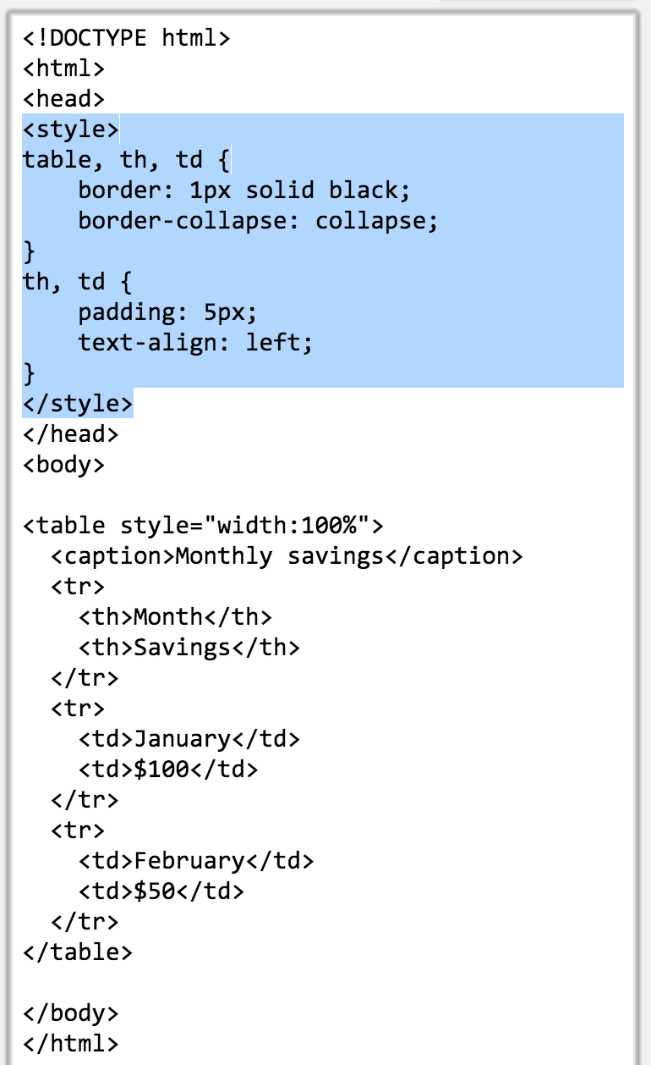
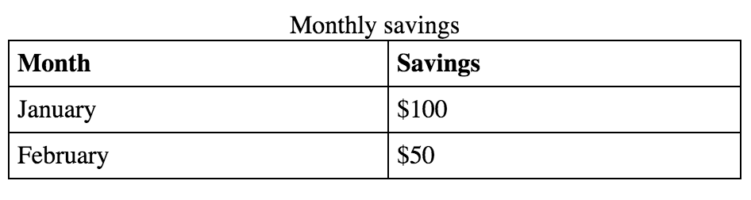
Tables
Tables <table> tag
Rows <tr> tag
Columns <td> tag
Headings <th> tag
Layout
Basics
Tables
Text
Images
Links
HTML and CSS
Lists
Notes:
Columns – table data.

Slide 23
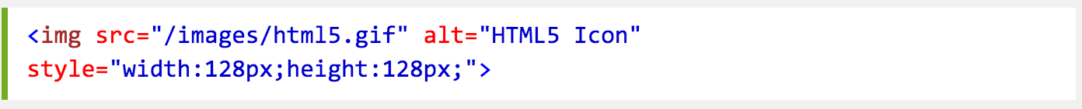
Images
Adding from local / online source
Alternative Descriptions alt
Layout
Basics
Tables
Text
Images
Links
HTML and CSS
Lists

Slide 24
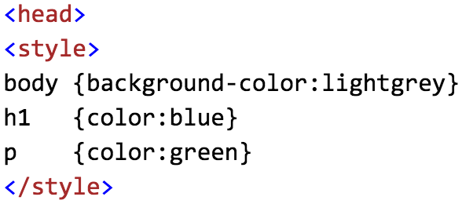
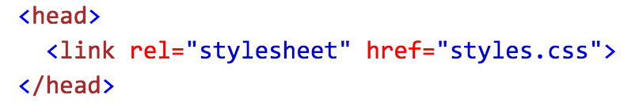
HTML and CSS
Inline – style attribute in HTML elements
Internal – using <style> element in HTML <head> section
External – using 1+ external CSS files
Layout
Basics
Tables
Text
Images
Links
HTML and CSS
Lists

Slide 25

CSS
Specifying the layout of web pages
Basics
Link States
Fonts
Selectors
Background
Box Model

Slide 26
Basics
Cascading Style Sheet
Describes the presentation of an HTML document
CSS saves a lot of work. It can control the layout of multiple web pages all at once
Save as: style.css
Basics
Link States
Fonts
Selectors
Background
Box Model
Notes:
Text Editors include vs code - works on everything - linux mac windows

Slide 27
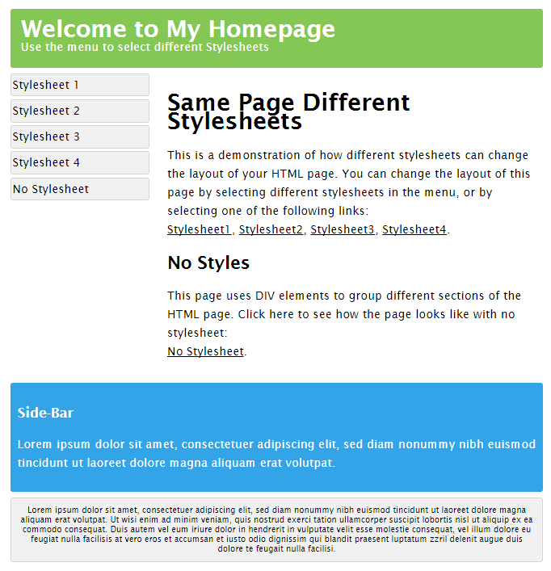
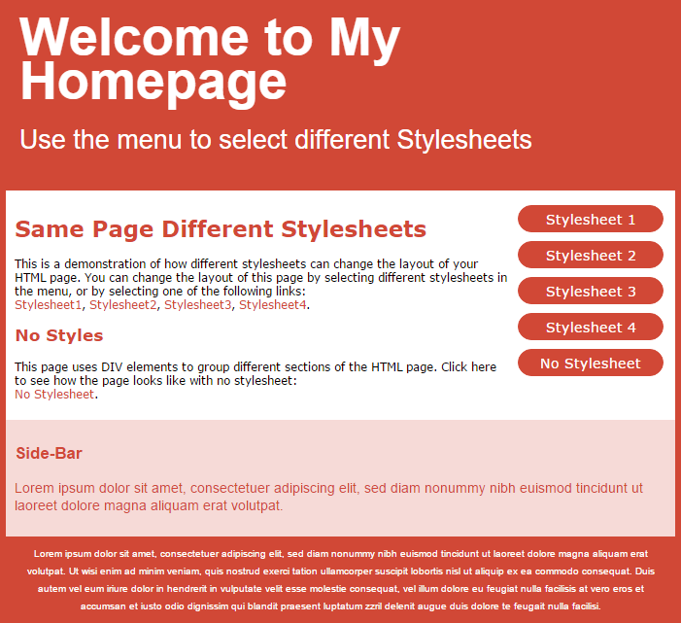
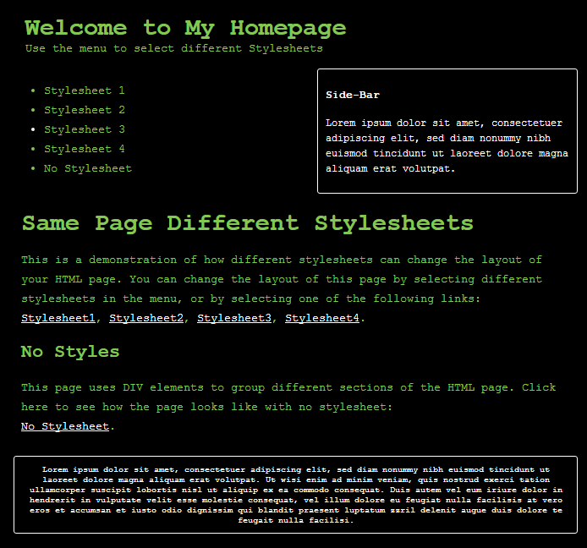
Same page different stylesheets
Basics
Link States
Fonts
Selectors
Background
Box Model
All different external .css files!
Notes:
CSS is used to define styles for your web pages, including the design, layout and variations in display for different devices and screen sizes.
Style definitions saved in exte

Slide 28
Yellow Header
h1 { color: yellow; font-size: 60px; }
Hello World! → Hello World!
Basics
Link States
Fonts
Selectors
Background
Box Model

Slide 29
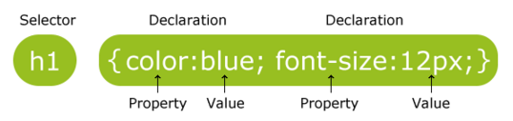
Syntax
Selector – points to the HTML element you want to style
Declaration block – contains 1+ decelerations separated by ;
Declaration – Property name : Value
/* This is a single-line comment */
Basics
Link States
Fonts
Selectors
Background
Box Model

Slide 30
Selectors
Element – selects elements based on the element name
<p>Hello</p>
p { color: red; }
ID – uses the id attribute of an HTML element to select an element
<p id=“para1”>Hello</p>
#para1 { color: red; }
Class - selects elements with a specific class attribute
<p class=“special”>Hello</p>
.special { color: red; }
Basics
Link States
Fonts
Selectors
Background
Box Model
Notes:
Reminder; IDs are unique while classes are not. So you can change multiple elements with classes/element

Slide 31
Selectors
Class – specify elements that should be effected by a class
<p class=“special”>Hello</p>
p.special { color: red; }
Grouping – same style definitions , separated with a comma
h1, h2, p { color: red;}
Css declarations at the bottom take precedence
p { color: yellow; font-size;60px; }
p { color: red; }
______
Hello!
Hello!
Basics
Link States
Fonts
Selectors
Background
Box Model

Slide 32
Font
Font Style – specify text style normal, italic, oblique
font-style: italic;
Font Size – size of the text
font-size: 40px; /* absolute in pixels */
font-size: 2.5em; /* relative 1em is equal to current font size, default text size in browsers is 16px “
Basics
Link States
Fonts
Selectors
Background
Box Model

Slide 33
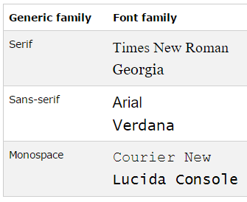
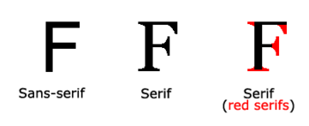
Fonts – font family – font of text
Generic family – group of font with a similar look
Font family – specific font family
p { font-family: "Times New Roman", Times, serif; }
Multiple font names are used so that if a browser doesn’t recognize the first font, tries the next …
Basics
Link States
Fonts
Selectors
Background
Box Model

Slide 34
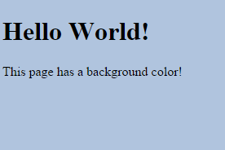
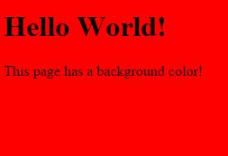
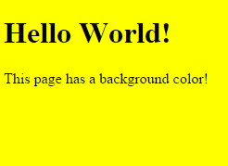
Background
Specifies the background effects of an element
Specifies the color of the element – HEX, RGB, name
background-color: #b0c4de;
background-color: rgb(255,0,0);
background-color: yellow;
Basics
Link States
Fonts
Selectors
Background
Box Model

Slide 35
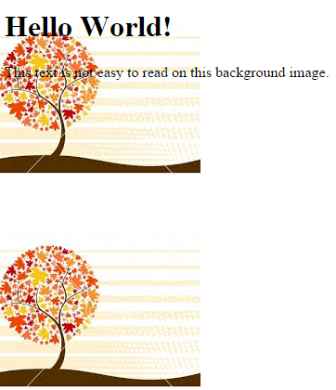
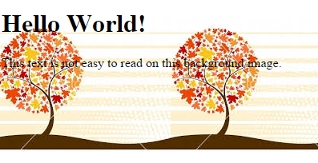
Background
Specifies an image to use as the background – default repeated
background-image: url(“img_tree.png");
Repeat horizontally/vertically
background-repeat: repeat-y; /* repeat vertically */
Basics
Link States
Fonts
Selectors
Background
Box Model

Slide 36



Background
Specifies the size of the background
background-size: 450px 450px;
background-size: cover;
background-size: contain;
Can set all the background properties in 1 declaration
background: #ffffff url("img_tree.png") no-repeat right top;
Basics
Link States
Fonts
Selectors
Background
Box Model

Slide 37
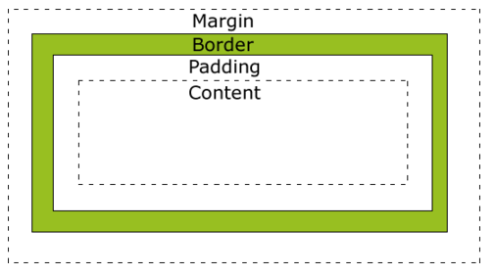
Box Model
All HTML elements can be considered as boxes
Box model – a box that wraps around every HTML element
Content – content of the box – where text + images appear
Padding – clears an area around content – transparent
Border – goes around padding + content – can change style
Margin – clears an area around the border – transparent
Basics
Link States
Fonts
Selectors
Background
Box Model

Slide 38
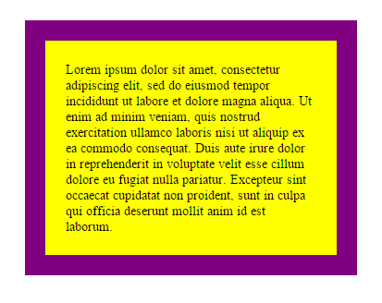
Box Model Example
div { width: 300px; padding: 25px; border: 25px solid purple; margin: 25px; }
padding-top: 25px
padding-right: 30px ….
Basics
Link States
Fonts
Selectors
Background
Box Model
Notes:
Can do padding for all sides or individual sides by different declarations
This can be done for all other elements in box model – ie border: border-style: solid, border-width: 5px;

Slide 39
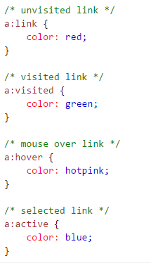
Link States
Links can be styled differently depending on what state they are in
a:hover MUST come after a:link and a:visited
a:active MUST come after a:hover
Basics
Link States
Fonts
Selectors
Background
Box Model

Slide 40

JavaScript
Program the behavior of web pages

Slide 41
JavaScript
One of the most popular programming languages in the world
Essential component of websites and web applications
All modern browsers support JavaScript
JavaScript is also used in non- web based environments like .pdf
It is not Java!
“JavaScript is to Java as Car is to Carpet”

Slide 42
Showing Output
Different ways to show output
alert(“Hello World”)
document.write(“Hello World”)
document.getElementById("demo").innerHTML = “Hello World”
console.log(“Hello World”)

Slide 43
Functions
function name(parameter1, parameter2) { code to be executed }
function addNumbers(p1, p2) { return p1 + p2; }
Notes:
A JavaScript function is a block of code designed to perform a particular task.

Slide 44
Calling Functions
Functions can be called when:
-An event occurs
<button onclick='getElementById("demo").innerHTML=Date()’>
-Called by another JavaScript code
function addNumbers(){
return getNumberOne() + getNumberTwo();
}

Slide 45
Common HTML Events
Event | Description
onchange | An HTML element has been changed
onclick | The user clicks an HTML element
onmouseover | The user moves the mouse over an HTML element
onmouseout | The user moves the mouse away from an HTML element
onkeydown | The user pushes a keyboard key
onload | The browser has finished loading the page
The list is much longer: W3Schools JavaScript Reference HTML DOM events

Slide 46
Objects
var car = {
name: “Tesla”,
model: “P90D”,
colour: “white”
}
Or add them as you go
car.price = 120000;

Slide 47
Thank You

